Slide 1
Spring Boot Webapp
1

Slide 2
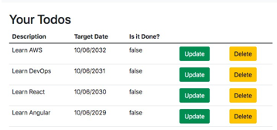
Building Your First Web Application
Building Your First Web Application can be complex:
Web App concepts (Browser, HTML, CSS, Request,
Response, Form, Session, Authentication)
Spring MVC (Dispatcher Servlet, View Resolvers, Model, View, Controller, Validations ..)
Spring Boot (Starters, Auto Configuration, ..)
Frameworks/Tools (JSP, JSTL, JPA, Bootstrap, Spring Security, MySQL, H2)
Goal: Build Todo Management Web App with a
Modern Spring Boot Approach
AND explore all concepts in a HANDS-ON way
Notes:
Spring Boot auto-configuration automatically configures the Spring application based on the jar dependencies that we have added.
For example, if the H2 database Jar or mysql jar is present in the classpath and we have not configured any beans related to the database manually, the Spring Boot's auto-configuration feature automatically configures it in the project.
We can enable the auto-configuration feature by using the annotation @EnableAutoConfiguration. But this annotation does not use because it is wrapped inside the @SpringBootApplication annotation.
@SpringBootApplication=@ComponentScan+@EnableAutoConfiguration+@Configuration
The annotation @SpringBootApplication is the combination of three annotations: @ComponentScan, @EnableAutoConfiguration, and @Configuration.
We use @SpringBootApplication annotation instead of using @EnableAutoConfiguration.
When we add the spring-boot-starter-web dependency in the project, Spring Boot auto-configuration looks for the Spring MVC is on the classpath. It auto-configures dispatcherServlet, a default error page, and web jars.
Similarly, when we add the spring-boot-starter-data-jpa dependency, we see that Spring Boot Auto-configuration, auto-configures a datasource and an Entity Manager.
All auto-configuration logic is implemented in spring-boot-autoconfigure.jar

Slide 3
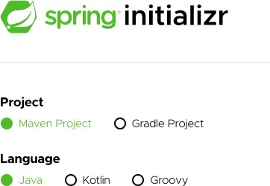
Spring Initializr
My favorite place on the internet
Easiest way to create Spring Boot Projects Remember:
1: SpringBoot: Use latest released version
Avoid M1,M2,M3, SNAPSHOT!
2: Java: Use latest Version
Java uses 6 month release patterns
Spring Boot 3.0+ works on Java 17+
3: Use latest Eclipse Java EE IDE version

Slide 4
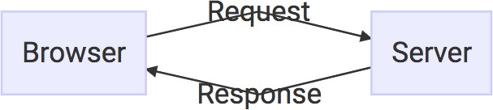
How does Web work?
A: Browser sends a request
HttpRequest
B: Server handles the request
Your Spring Boot Web Application
C: Server returns the response
HttpResponse
Show request-response flow using simple HelloWorld web-application using with Welcome/SayHello controller.

Slide 5
Understanding Logging
logging.level.some.path=debug logging.level.some.other.path=error logging.file.name=logfile.log
private Logger logger = LoggerFactory.getLogger(this.getClass()); logger.info("postConstruct");
Knowing what to log is an essential skill to be a great programmer
Spring Boot makes logging easy
spring-boot-starter-logging
Default: Logback with SLF4j
Typical Log Levels: ERROR, WARN, INFO, DEBUG, or TRACE

Slide 6
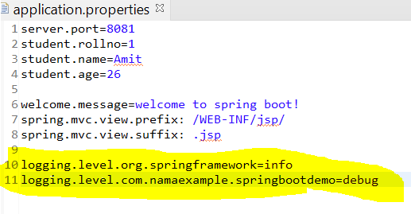
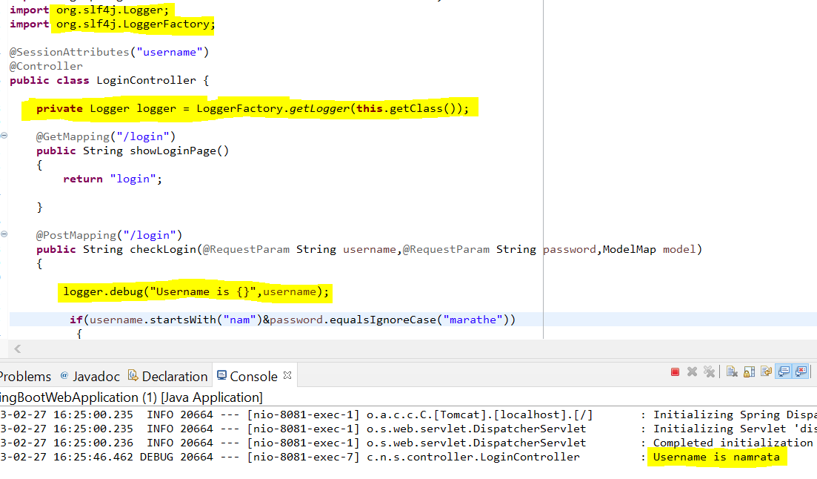

Slide 7
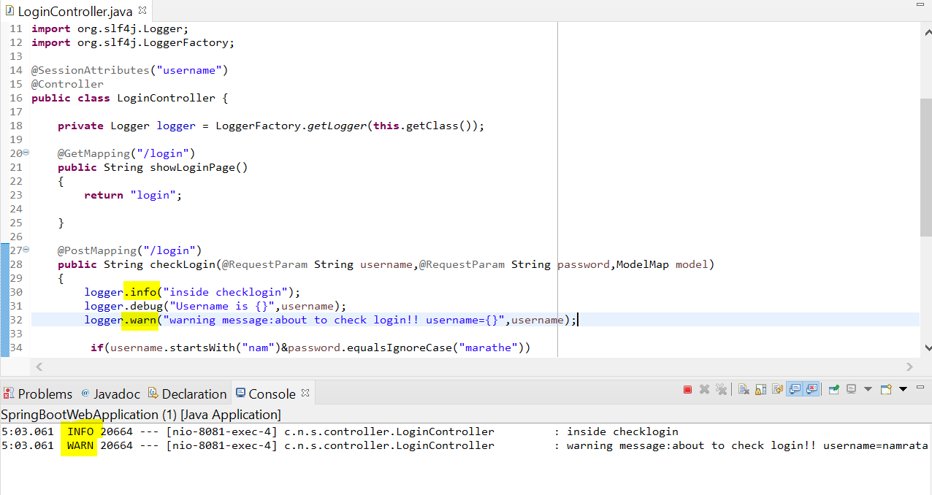
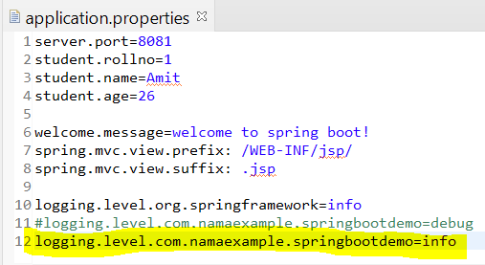
See that logger.debug statements in this class do not get printed as logging level of this class rather entire package is set to info. debug level is below info so it wont be printed for login level set to info. However, as warning level is above info level, warning messages get printed.

Slide 8
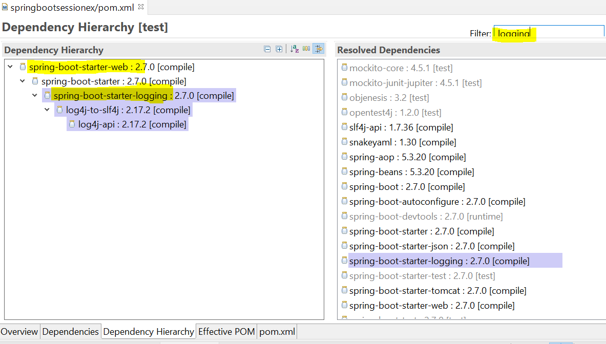
Note: see that - Spring-boot-starter-logging jar is part of spring-boot-starter-web jar added in pom.xml

Slide 9
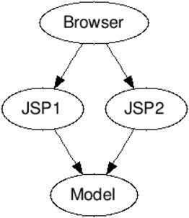
Peek into History - Model 1 Arch.
ALL CODE in Views (JSPs, ...)
View logic
Flow logic
Queries to databases
Disadvantages:
VERY complex JSPs
ZERO separation of concerns Difficult to maintain

Slide 10
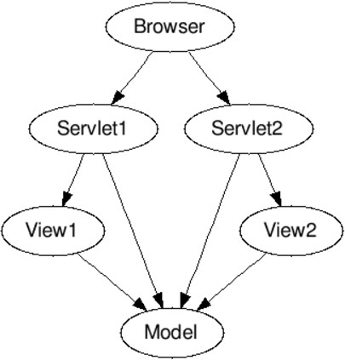
Peek into History - Model 2 Arch.
How about separating concerns?
Model: Data to generate the view
View: Show information to user
Controller: Controls the flow
Advantage: Simpler to maintain
Concern:
Where to implement common features to all controllers?

Slide 11
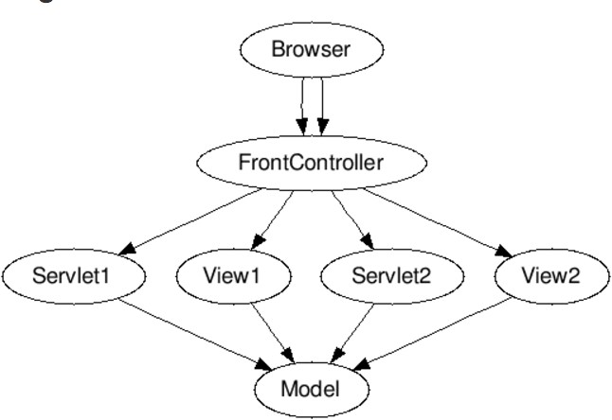
Model 2 Architecture - Front Controller
Concept: All requests flow into a central controller
Called as Front Controller
Front Controller controls flow to Controller's and View's
Common features can be implemented in the Front
Controller

Slide 12
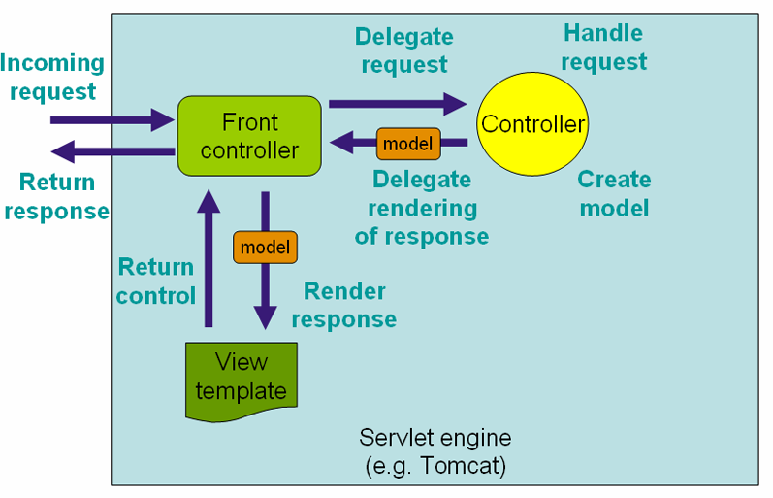
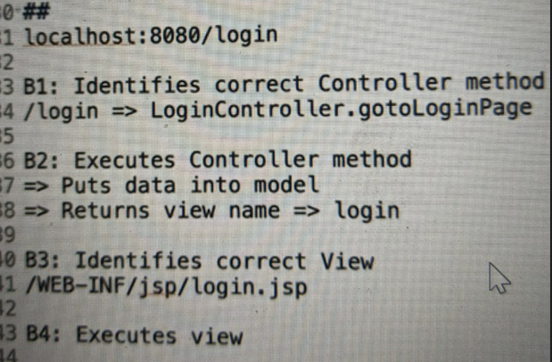
Spring MVC Front Controller - Dispatcher Servlet
A: Receives HTTP Request
B: Processes HTTP Request
B1: Identifies correct Controller method
Based on request URL
B2: Executes Controller method
Returns Model and View Name
B3: Identifies correct View
Using ViewResolver
B4: Executes view
Model is made available to the view
C: Returns HTTP Response

Slide 13
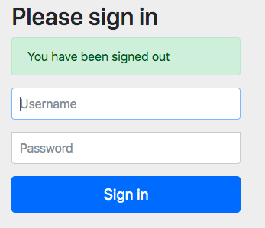
Session vs Request Scopes
All requests from browser are handled by our web application deployed on a server
Request Scope: Active for ONLY a single request
Once the response is sent back, the request attributes will be removed from memory
These cannot be used for future requests Recommended for most use cases
Session Scope: Details stored across multiple requests
Be careful about what you store in session (Takes
additional memory as all details are stored on server)

Slide 14

Validations with Spring Boot
1: Spring Boot Starter Validation
pom.xml
2: Command Bean (Form Backing Object)
2-way binding (todo.jsp & TodoController.java)
3: Add Validations to Bean
Todo.java
4: Display Validation Errors in the View
todo.jsp

Slide 15
Transition from JEE to Spring Boot Web App

Slide 16
Understanding Component Scan
@SpringBootApplication @ComponentScan("com.springboot.package1") @ComponentScan({"com.springboot.package1", "com.springboot.package2"})
You can define components using these annotations
@Component, @Controller, @Repository, @Service
How does Spring Framework know which Packages to search for components?
Component Scan
Understanding Component Scan helps you to debug problems (with Spring and Spring Boot)
@SpringBootApplication defines an automatic component scan
You can customize it by defining additional @ComponentScan
Example Errors:
My URL is not working
No qualifying bean of type found

Slide 17
Peek into History - Jakarta EE
Java SE: Java Platform, Standard Edition
JDK + JRE
Build and Run Simple Java Applications
Java EE (or J2EE): Build Web Applications
First released in December 1999
Defines Specs: Servlet, JSP, JMS, EJB, JPA, JAX-RS etc.. Was maintained by Oracle
Jakarta EE: New form of Java EE
Oracle moved Java EE to Eclipse Foundation
AND Java EE was renamed to Jakarta EE Features remain same BUT different ownership Namespace move from javax to jakarta

Slide 18
Quick Review : Web App with Spring Boot
HTML: Hyper Text Markup Language
Tags like html, head, body, table, link are part of HTML
CSS: Cascading Style Sheets
Styling of your web page is done using CSS
We used Bootstrap CSS framework
JavaScript: Do actions on a web page
Example: Display a Date Popup (Bootstrap Datepicker)
JSTL: Display dynamic data from model
<c:forEach items="${todos}" var="todo">
Spring form tag library: Data binding-aware tags for handling form elements
<form:form method="post" modelAttribute="todo">

Slide 19
Quick Review : Web App with Spring Boot
DispatcherServlet: All requests flow into a central controller (Front Controller)
View: Show information to user
Controller: Controls the flow
Model: Data to generate the view
Spring Boot Starters: Fast track building apps
Spring Boot Starter Web
Spring Boot Starter Validation Spring Boot Starter Security Spring Boot Starter Data JPA

Slide 20
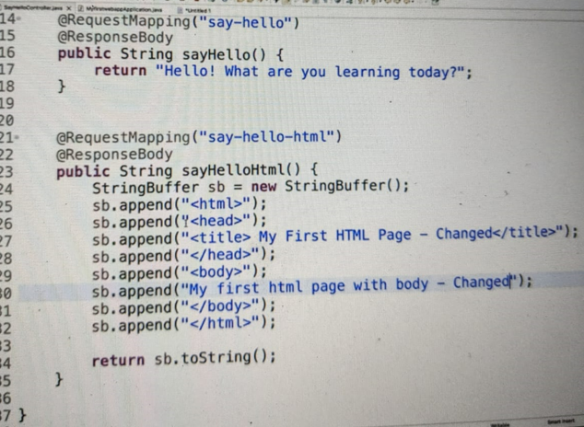
Using @Controller, @RequestMapping, @ResponseBody and writing MVC web app Controller.
Note: It does not yet denote how to return and resolve jsp view page..

Slide 21
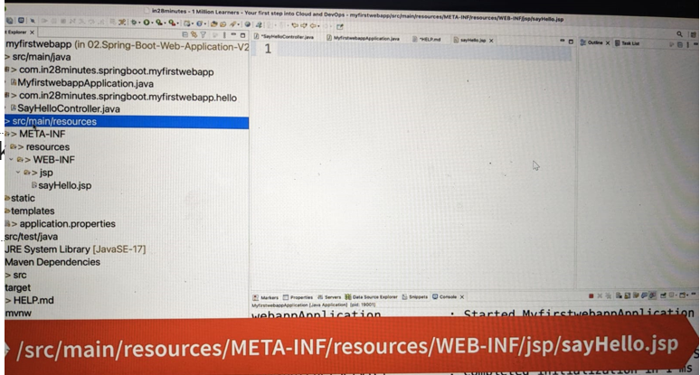
Structure to add JSP view page:-

Slide 22
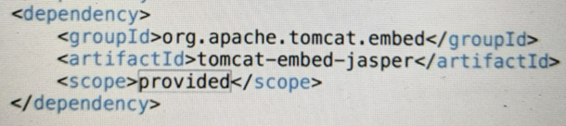
To access JSP page in Tomcat, add below dependency in POM. (scope is provided because this jar is already present as part of embedded tomcat jar.)

Slide 23
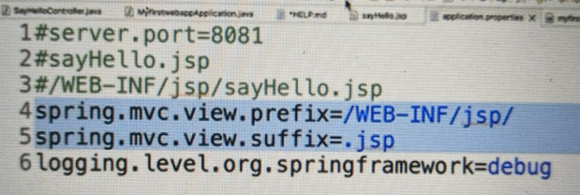
Inside application.properties file, configure the path to JSP page for View Resolver as below.
View Resolver picks view-name string returned by webapp method and prepends the prefix and appends the suffix string configured in properties file to it -> to get the path/location of jsp file inside webapp.
For e.g.:- if view name “sayhello” is returned by get web-method then view resolver will resolve jsp page location as - /WEB-INF/jsp/sayhello.jsp

Slide 24
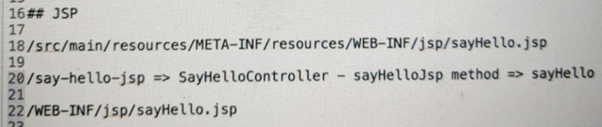
Actual location of JSP page
JSP page name resolved by View Resolver
Request-response-chain

Slide 25
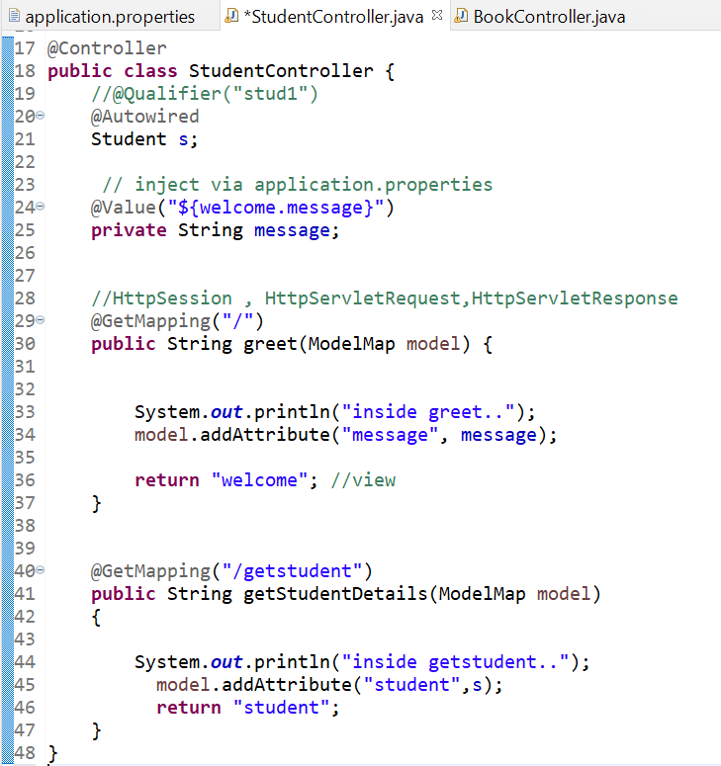
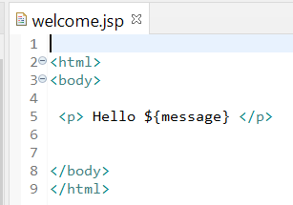
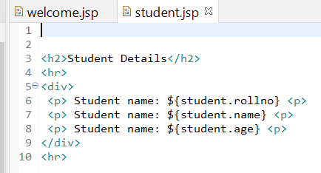
JSP Expression Language EL - ${…}
Using Model (ModelMap)

Slide 26
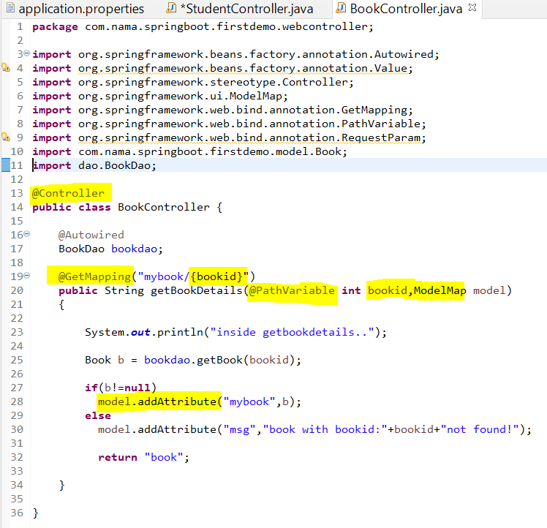
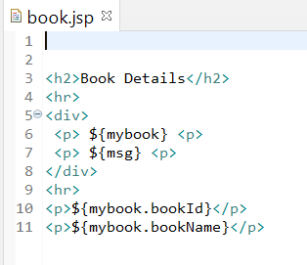

Slide 27
To-do Web-Application
Session-Handling example using Login Controller and To-do Controller
Also depicts use of Dao Class dao-design pattern

Slide 28
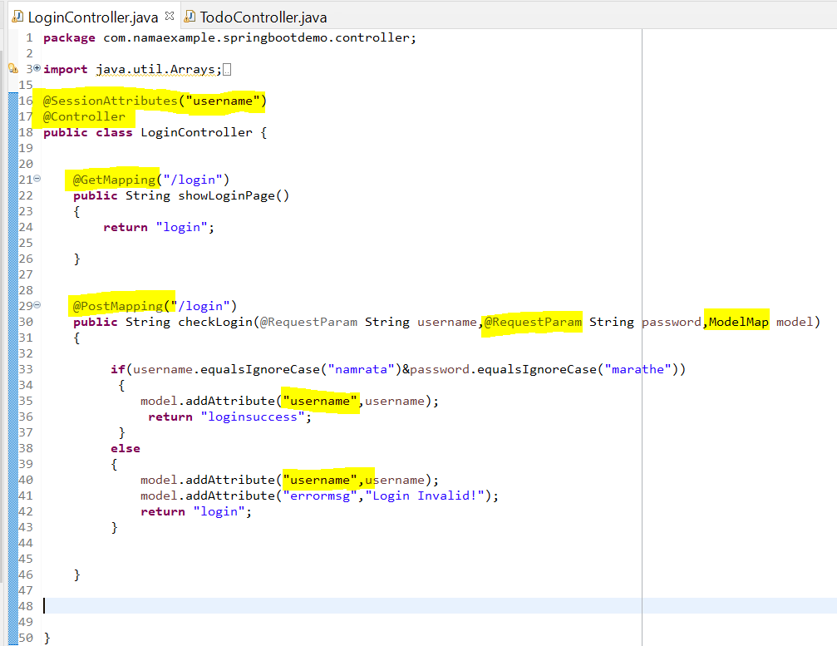

Slide 29
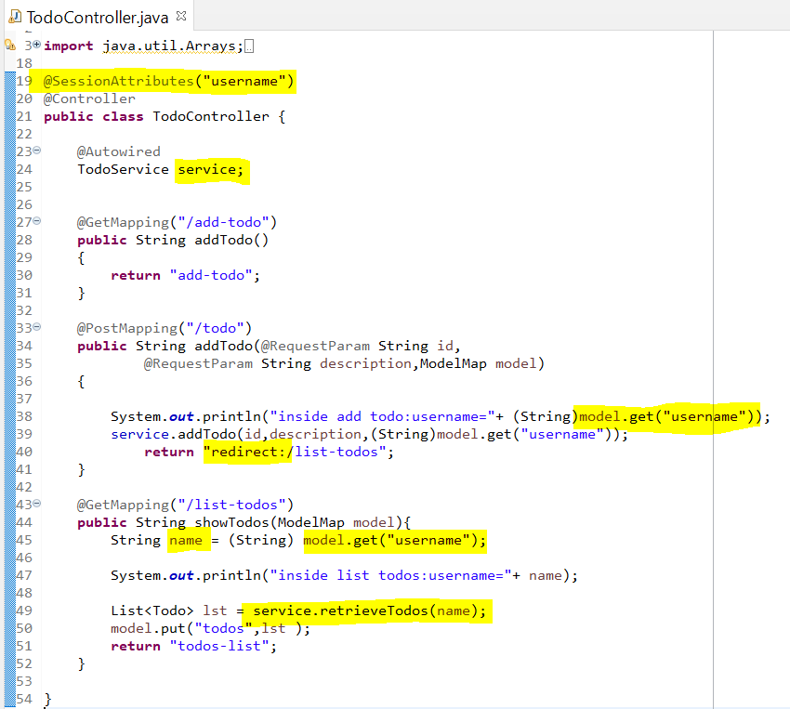

Slide 30
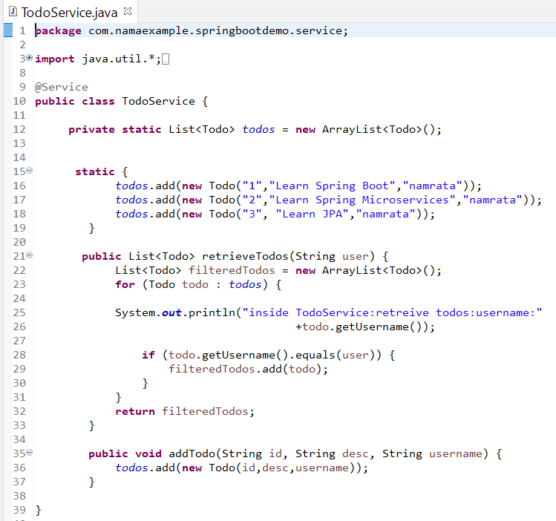

Slide 31
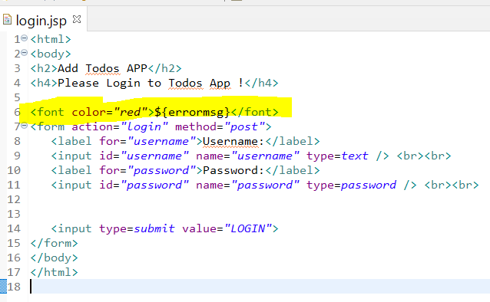
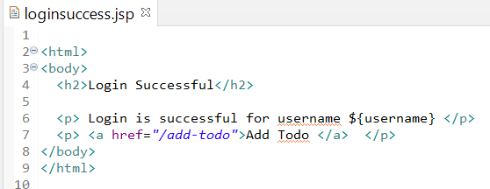

Slide 32
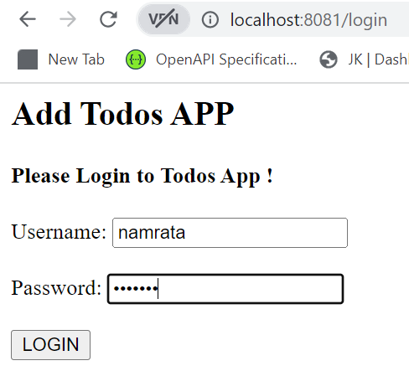
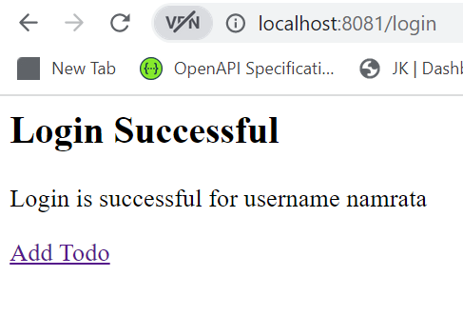

Slide 33
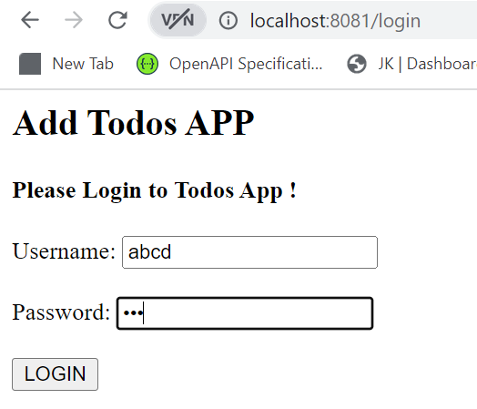
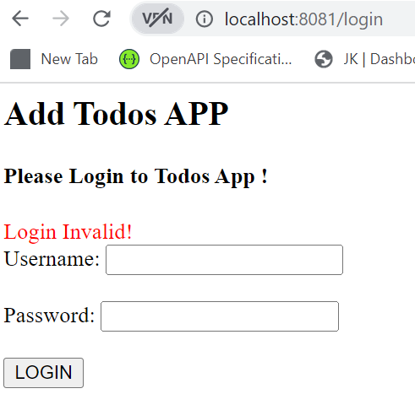

Slide 34
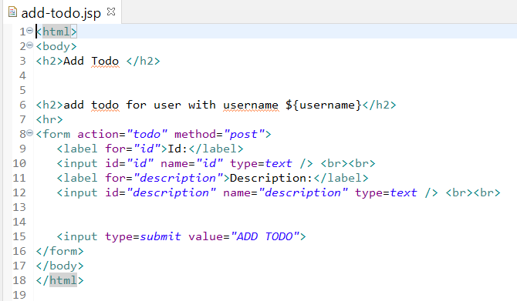
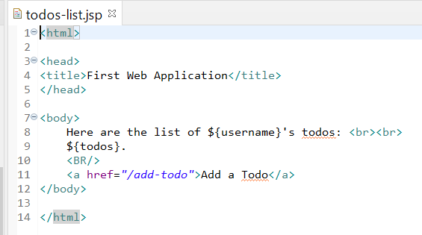

Slide 35
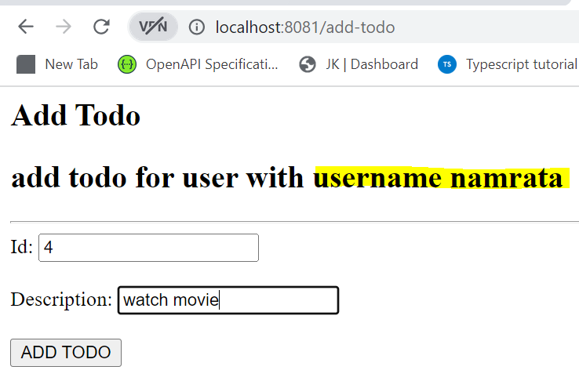
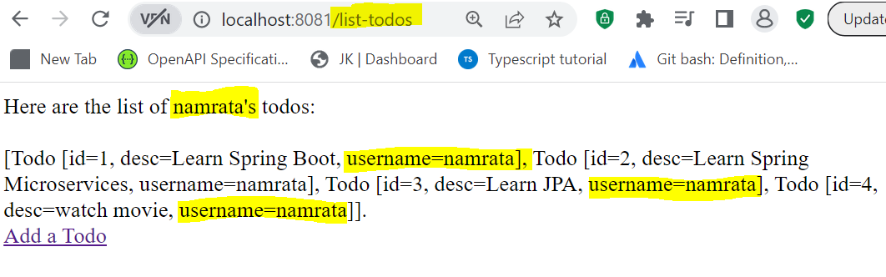
Note: Username is session attribute hence it is available to all JSP requests that are part of same session.

Slide 36
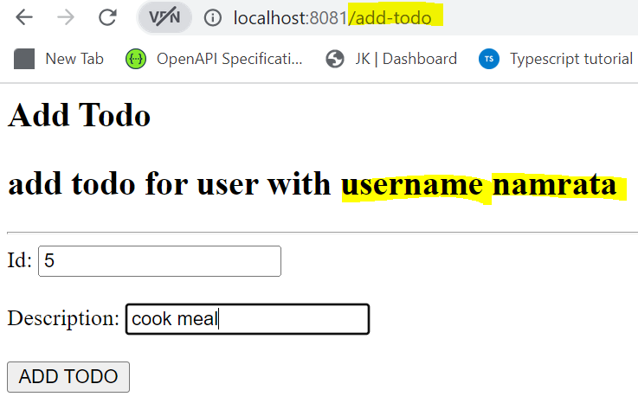
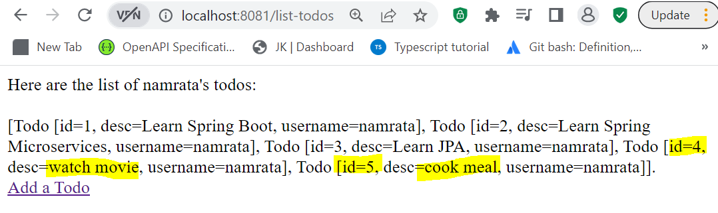
Note : Session handling is working. Username and Todo items with id 4 and 5 are added to same Todo-List as it’s part of same session!

Slide 37
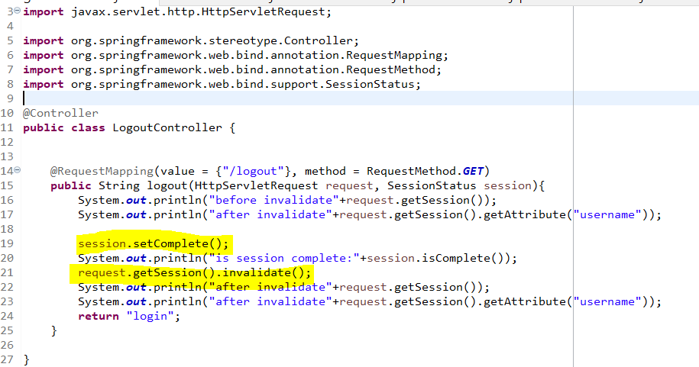
Note: clicking on Logout link invoked Logout controller which invalidates the session and returns the welcome/login page

Slide 38
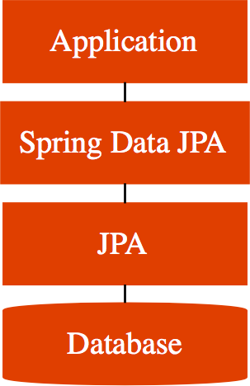
Spring Boot Auto Configuration Magic - Data JPA
We added Data JPA and H2 dependencies:
Spring Boot Auto Configuration does some magic:
Initialize JPA and Spring Data JPA frameworks
Launch an in memory database (H2)
Setup connection from App to in-memory database Launch a few scripts at startup (example: data.sql)
Remember - H2 is in memory database
Does NOT persist data
Great for learning
BUT NOT so great for production Let's see how to use MySQL next!

Slide 39
@SpringBootApplication
The annotation @SpringBootApplication is the combination of three annotations:
@ComponentScan, @EnableAutoConfiguration, and @Configuration.

Slide 40
Spring and Spring Boot Release Cycles
What is the difference between these?
4.2.0 (SNAPSHOT)
4.4.5 (M3) 4.4.0
Release Number: MAJOR.MINOR.FIX
Spring and Spring Boot Release Cycle:
SNAPSHOT (versions under development) > Mile Stones > Released Version
Recommendation - Do NOT use SNAPSHOTs or M1 or M2 or M3
Prefer released versions!

